Slide 1
Lent term 2020
Things you should be doing now (on top of working hard on you’re A-levels)
Finding work experience – deadline April
Working on EPQ – deadline July

Slide 2
Work experience
Dates are 6th to 10th July (last week of term)
If you are doing D of E you should organise work experience in your own time (e.g. over summer)
When you have a placement, collect a blank FORM from the 6th Form Office, fill in the front page, and return it to the 6th Form Office.
It needs to be signed by your parents before you hand it in.
DEADLINE 3rd APRIL!

Slide 3
EPQ DEADLINES
October half-term | Identify a topic/question
Christmas | Provide evidence of research to tutor
February half-term | 2,000 words written and submitted
Easter holiday | 1st draft of whole thing written and submitted
Before May half-term | Presentation completed in Godwyn House – dates to follow
End of summer term | Completed EPQ and log-book submitted

Slide 4
EPQ DEADLINES
October half-term | Identify a topic/question
Christmas | Provide evidence of research to tutor
February half-term | 2,000 words written and submitted
End of Lent term | 1st draft of whole thing written and submitted
Before May half-term | Presentation completed in Godwyn House – dates to follow
End of summer term | Completed EPQ and log-book submitted

Slide 5
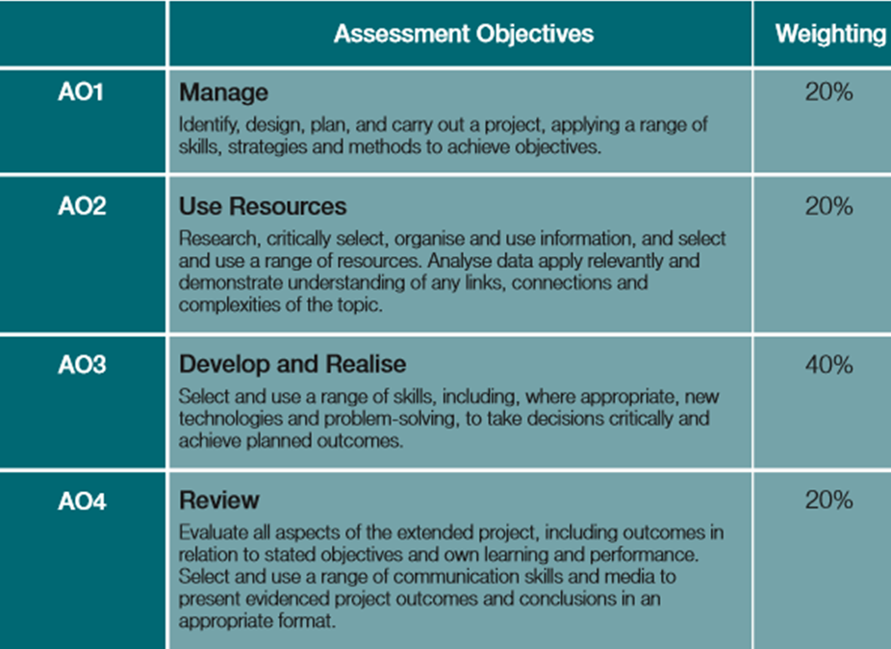
What the Exam Board Looks for
Progress-changes throughout the project
Planning and time management
Analysing sources
Evaluating your own progress
A lot of the marks come from YOUR LOGBOOK – fill this in as you go

Slide 6
What I wish I’d known earlier – by year 13

Slide 7
EPQ Advice – things you should do/know
Look at examples of good EPQs
Keep notes and rough planning; they can be included in the project
Have a timetabled plan and monitor whether you stick to it; even if you don’t it can get you marks!
When you write your project, make mini-conclusions as you go; write your 5000 words in sections and subsections.
Take photos of yourself doing your presentation and include them in the project
Keep note of where you find ALL your information – you will need a bibliography and references

Slide 8
Research sources
Primary-surveys, questionnaires, interviews
Secondary-websites, journal articles, data bases, books
Use a variety of sources
Analyse their usefulness and reliability and reflect on this in your project – you can’t easily get to top marks without this.

Slide 9
REFERENCES
Footnotes/endnotes in Word - demonstration
The best EPQs have at least 20-30 references

Slide 10
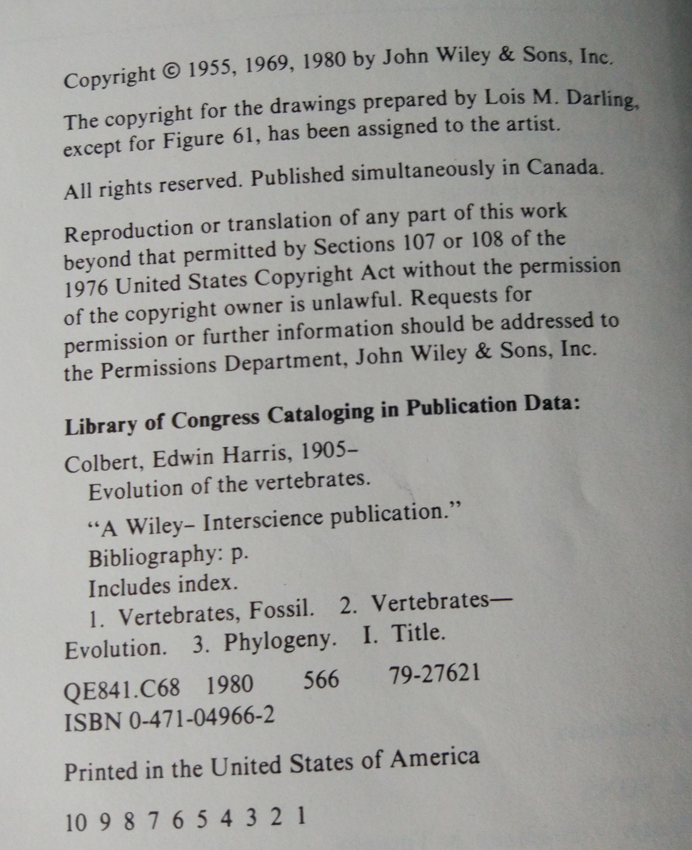
Book Example Reference
Publisher
Place of Publication
Colbert EH, (1980), Evolution of the vertebrates, United States of America, John Wiley& Sons, Inc
Surname of Author, Initials of Author (year of publication) Title of book, place of publication, publisher, series and volume number, page number

Slide 11
Journal Article Example Reference
Authors- within the report, this can be written as: Farias ME et al (2017)
Issue of journal and page number of journal
Name of journal article
Surname of author, Initials of author (year of publication) Title of article, title of journal , volume and issue of journal, page number, web address, date accessed
Volume number of journal

Slide 12
Website Example Reference
The Economist (2017) The siren song of a no-deal Brexit, https://www.economist.com/news/britain/21731868-governments-slow-conceding-ground-giving-new-life-delusion-it-would-be, date accessed 02/12/2017
Name of author if known or website (year of publication) Title of article, web address, date accessed

Slide 13
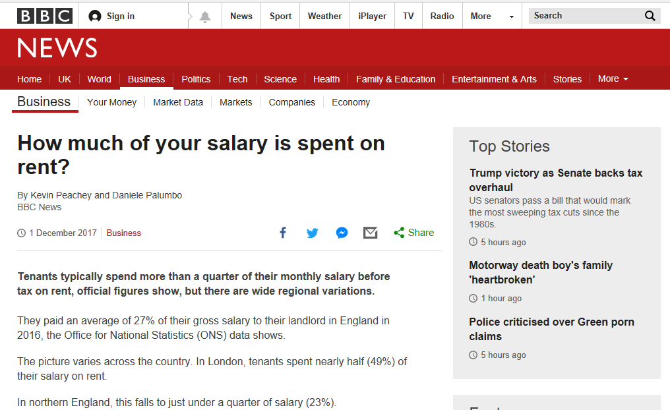
Online Newspaper Example Reference
Name of author(s), (year of publication) Title of article, title of website, web address, date accessed

